Slide 1


Data Communication and Computer Networks

Slide 2
Chapter 3. Data and Signals

Slide 3
Analog and Digital
To be transmitted, data must be transformed to electromagnetic signals
Data can be analog or digital. Analog data are continuous and take continuous values. Digital data have discrete states and take on discrete values.

Slide 4
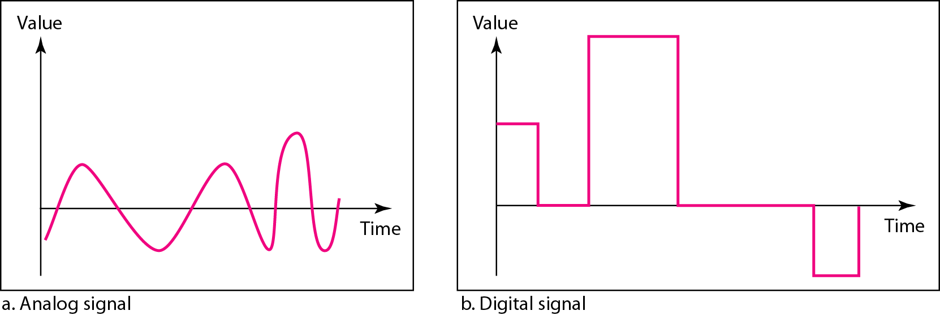
Analog and Digital Signals
Signals can be analog or digital form
Analog signals can have an infinite number of values in a range
digital signals can have only a limited number of values.

Slide 5
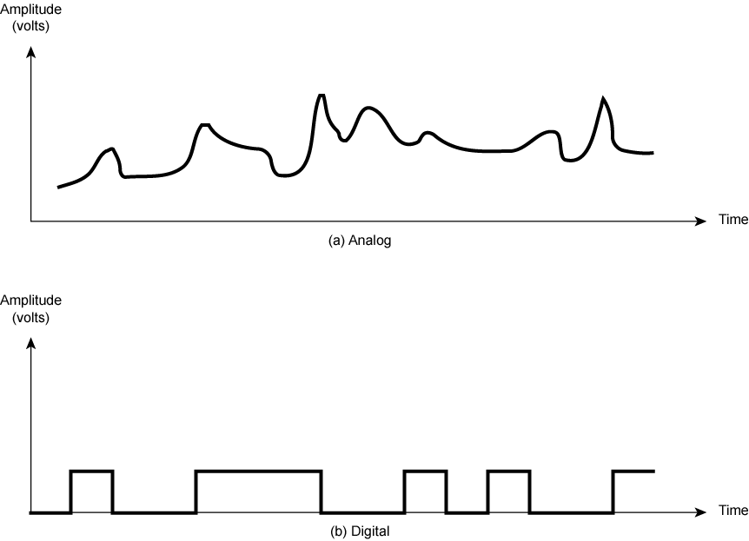
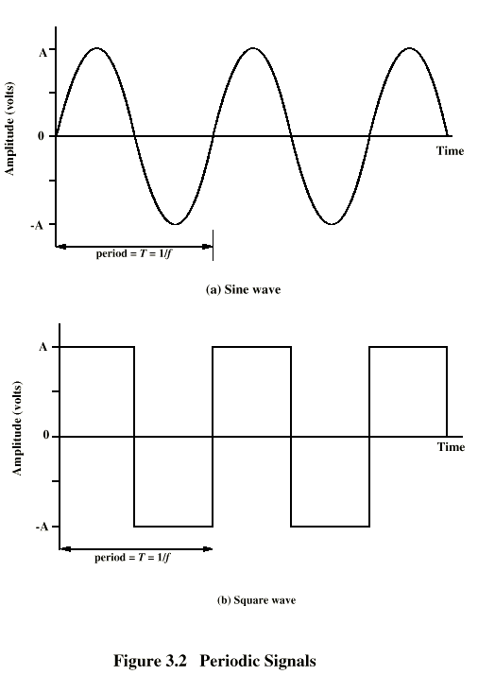
Periodic and Non periodic Signals
Periodic – completes a pattern within a measurable time frame, called a period
One full pattern is a cycle
Analog signals
A periodic – changes without exhibiting a pattern
Digital signals

Slide 6
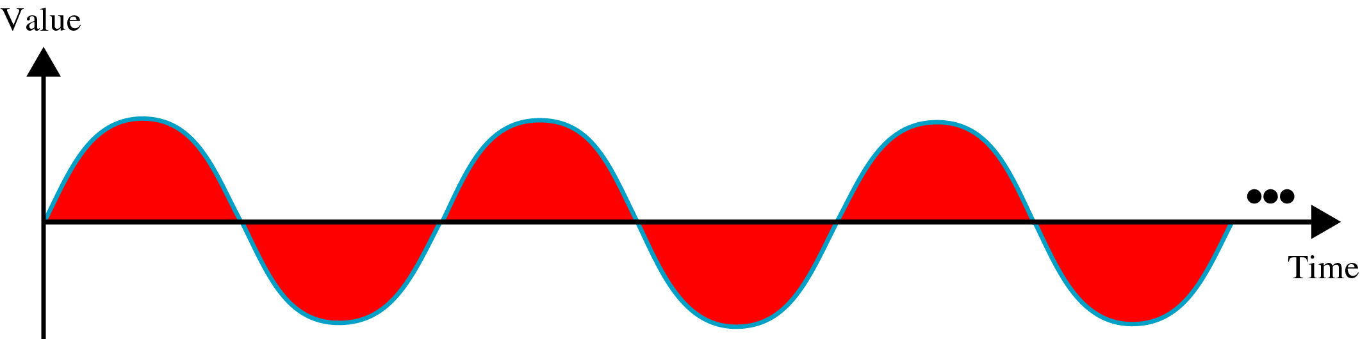
Periodic Analog Signals
Periodic analog signals can be classified as simple or composite.
A simple periodic analog signal, a sine wave, cannot be decomposed into simpler signals.
A composite periodic analog signal is composed of multiple sine waves
Sine wave is described by
Amplitude
Period (frequency)
phase

Slide 7
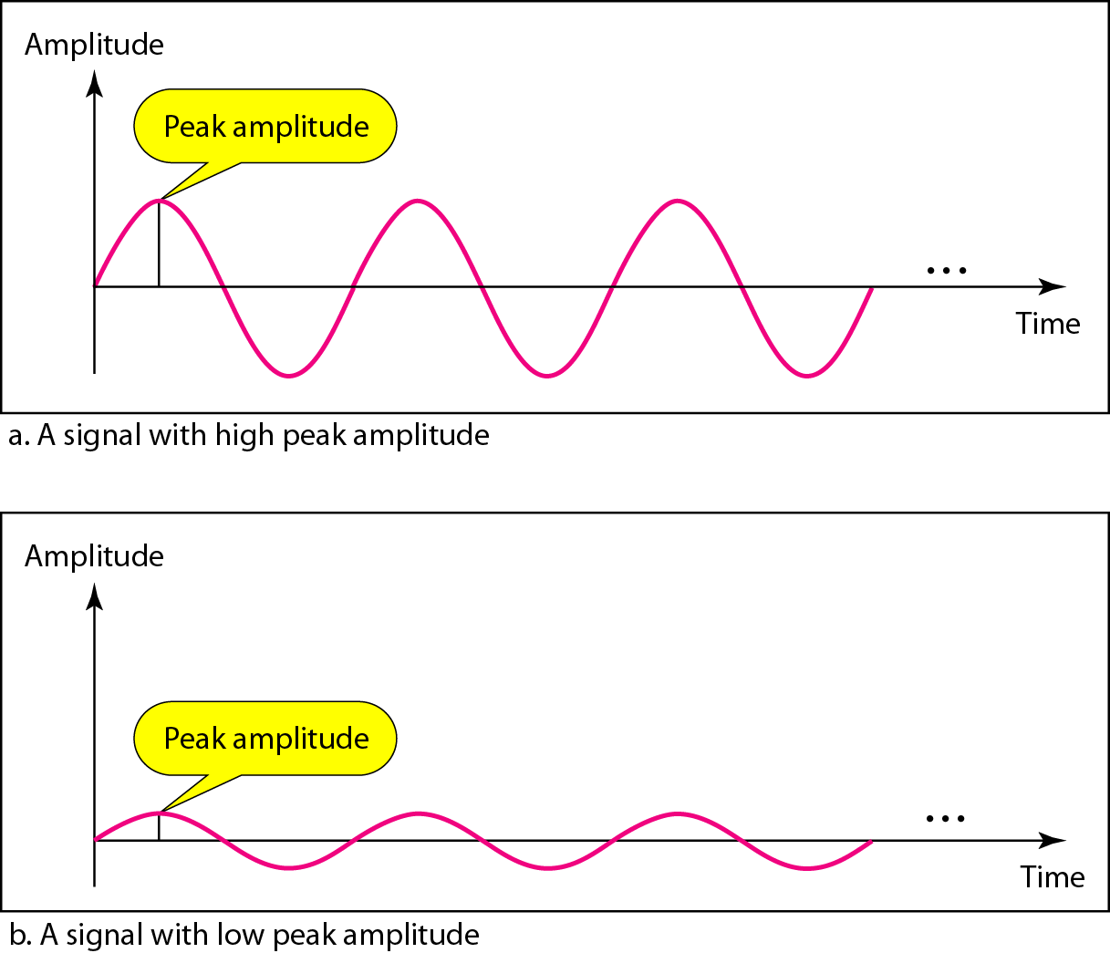
Amplitude
Absolute value of a signal’s highest intensity
Normally measured in volts

Slide 8
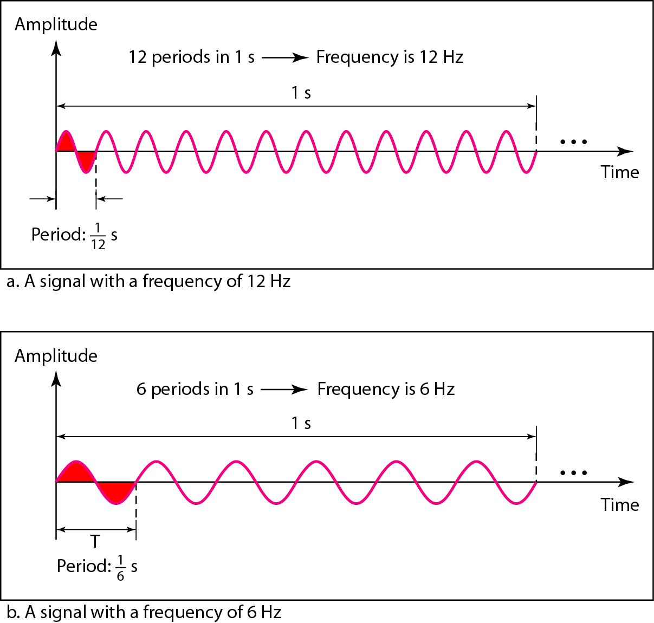
Period
Period - amount of time to complete one cycle, expressed in
seconds (s)
Frequency – number of periods in one second, inverse of period

Slide 9
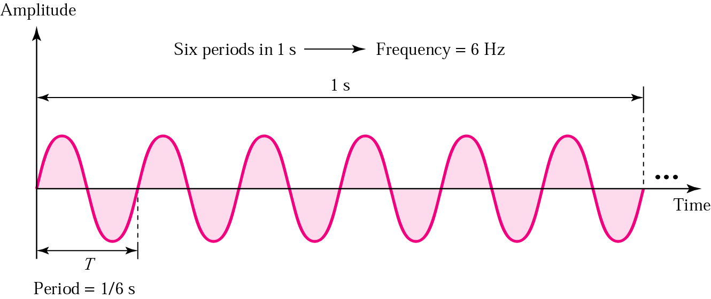
Frequency
Rate of change with respect to time, expressed in hertz (Hz)
Change in a short span of time means high frequency
Change over a long span of time means low frequency

Slide 10
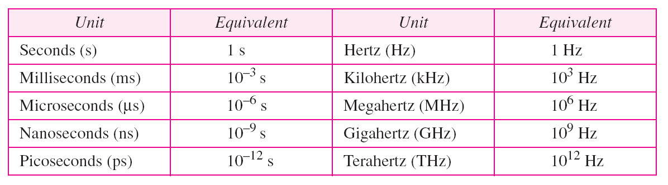
Units of Period and Frequency

Slide 11
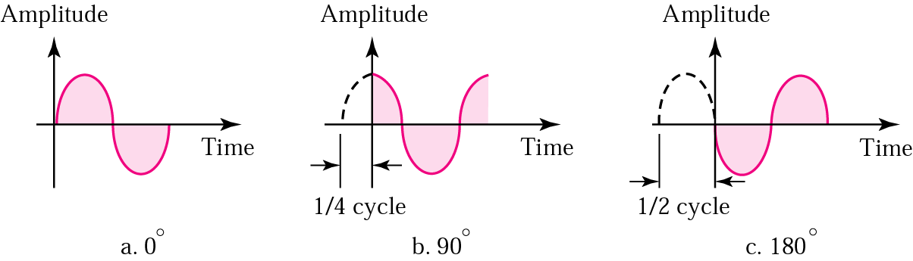
Phase
Position of the waveform relative to time zero
Measured in degrees or radians

Slide 12
Example 3.5
Express a period of 100 ms in microseconds, and express the corresponding frequency in kilohertz
From Table 3.1 we find the equivalent of 1 ms. We make the following substitutions:
100 ms = 100 × 10⁻³ s = 100 × 10⁻³ × 10⁶ ms = 10⁵ μs
Now we use the inverse relationship to find the frequency, changing hertz to kilohertz
100 ms = 100 × 10⁻³ s = 10⁻¹ s f = 1/10⁻¹ Hz = 10 × 10⁻³ KHz = 10⁻² KHz

Slide 13
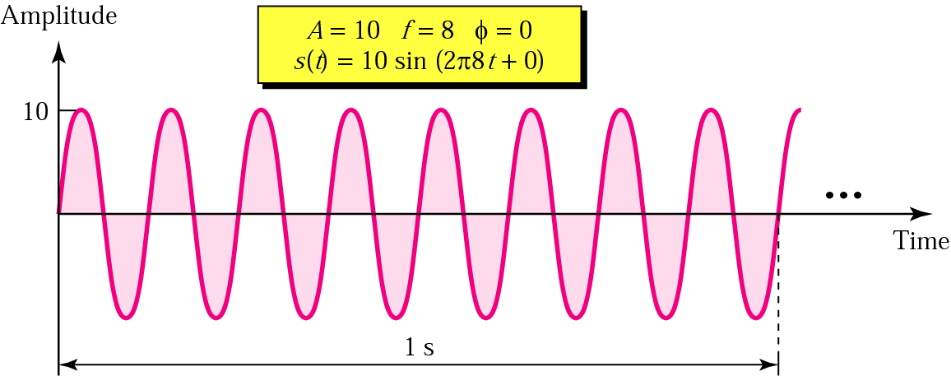
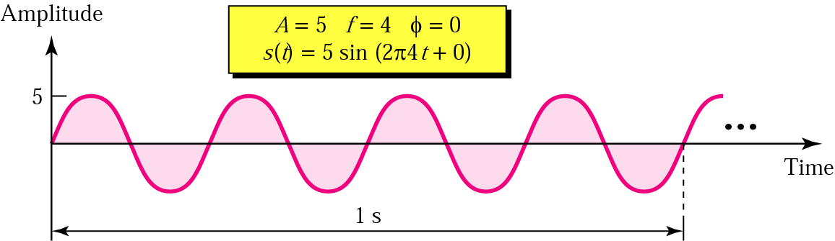
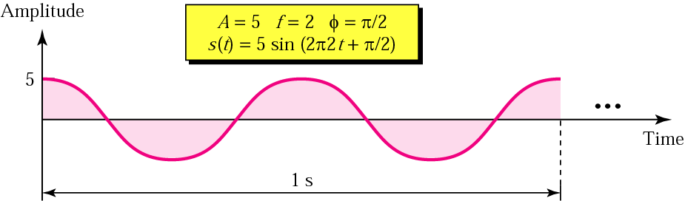
Sine Wave Examples

Slide 14
Example 3.6
A sine wave is offset one-sixth of a cycle with respect to time zero. What is its phase in degrees and radians?
We know that one complete cycle is 360 degrees.
Therefore, 1/6 cycle is
(1/6) 360 = 60 degrees = 60 x 2π /360 rad = 1.046 rad

Slide 15
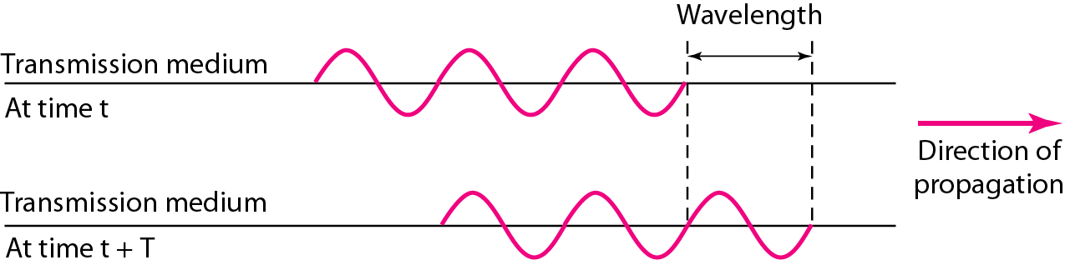
Wavelength
Another characteristic of a signal traveling through a transmission medium
Binds the period or the frequency of a simple sine wave to the propagation speed of the medium
Wavelength = propagation speed x period
= propagation speed/frequency

Slide 16
A single frequency sine wave is not useful in data communications;
we need to send a composite signal, a signal made of many simple sine waves

Slide 17
Composite Signals
A single-frequency sine wave is not useful in data communications; we need to send a composite signal, a signal made of many simple sine waves
When we change one or more characteristics of a single-frequency signal, it becomes a composite signal made of many frequencies
According to Fourier analysis, any composite signal is a combination of simple sine waves with different frequencies, phases, and amplitudes
If the composite signal is periodic, the decomposition gives a series of signals with discrete frequencies; if the composite signal is non periodic, the decomposition gives a combination of sine waves with continuous frequencies.

Slide 18
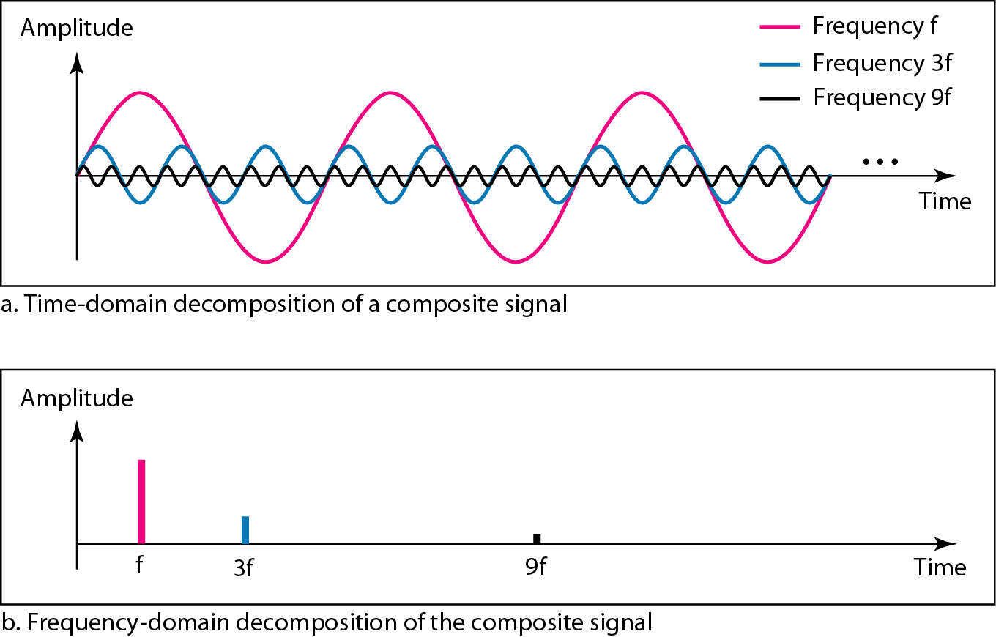
Composite Periodic Signal

Slide 19
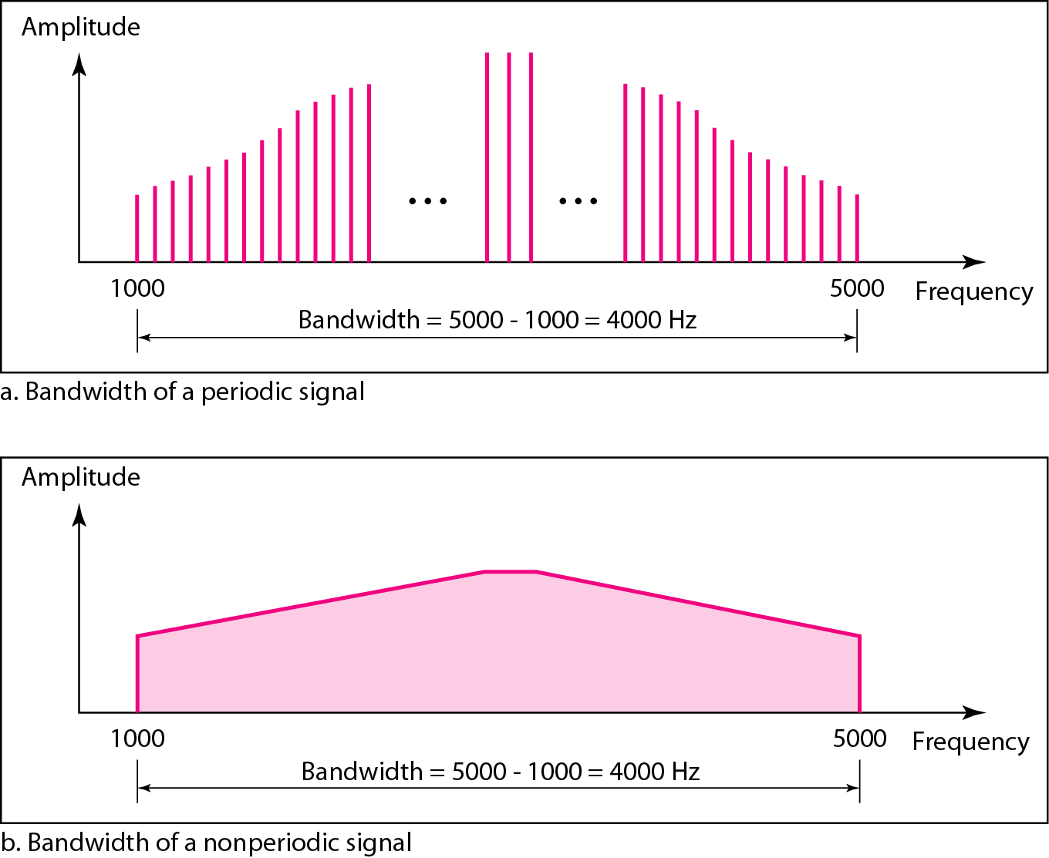
Bandwidth
The bandwidth of a composite signal is the difference between the highest and the lowest frequencies contained in that signal
It is a measurement of how fast data can be sent over a wired or wireless connection, usually measure in bits per second.

Slide 20
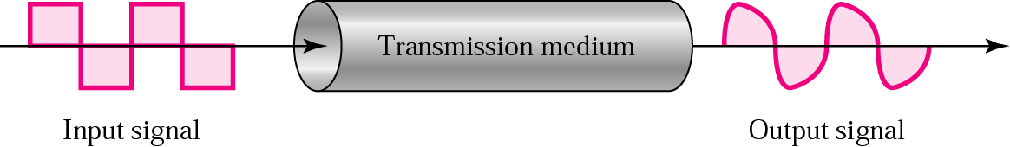
Signal Corruption

Slide 21
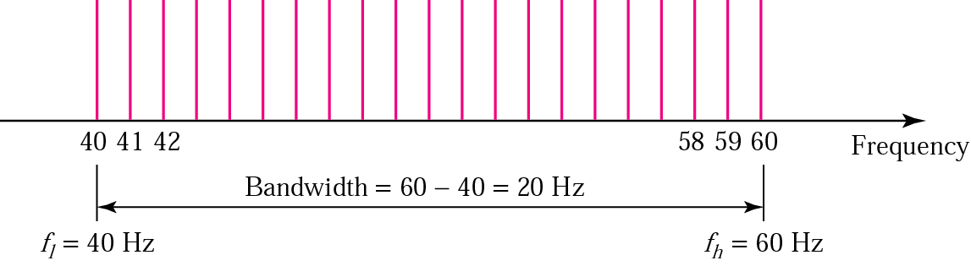
Example 3.11
A signal has a bandwidth of 20 Hz. The highest frequency is 60 Hz. What is the lowest frequency? Draw the spectrum if the signal contains all integral frequencies of the same amplitude
B = f_{h} - f_{l}, 20 = 60 – f_{l}, f_{l} = 60 - 20 = 40 Hz

Slide 22
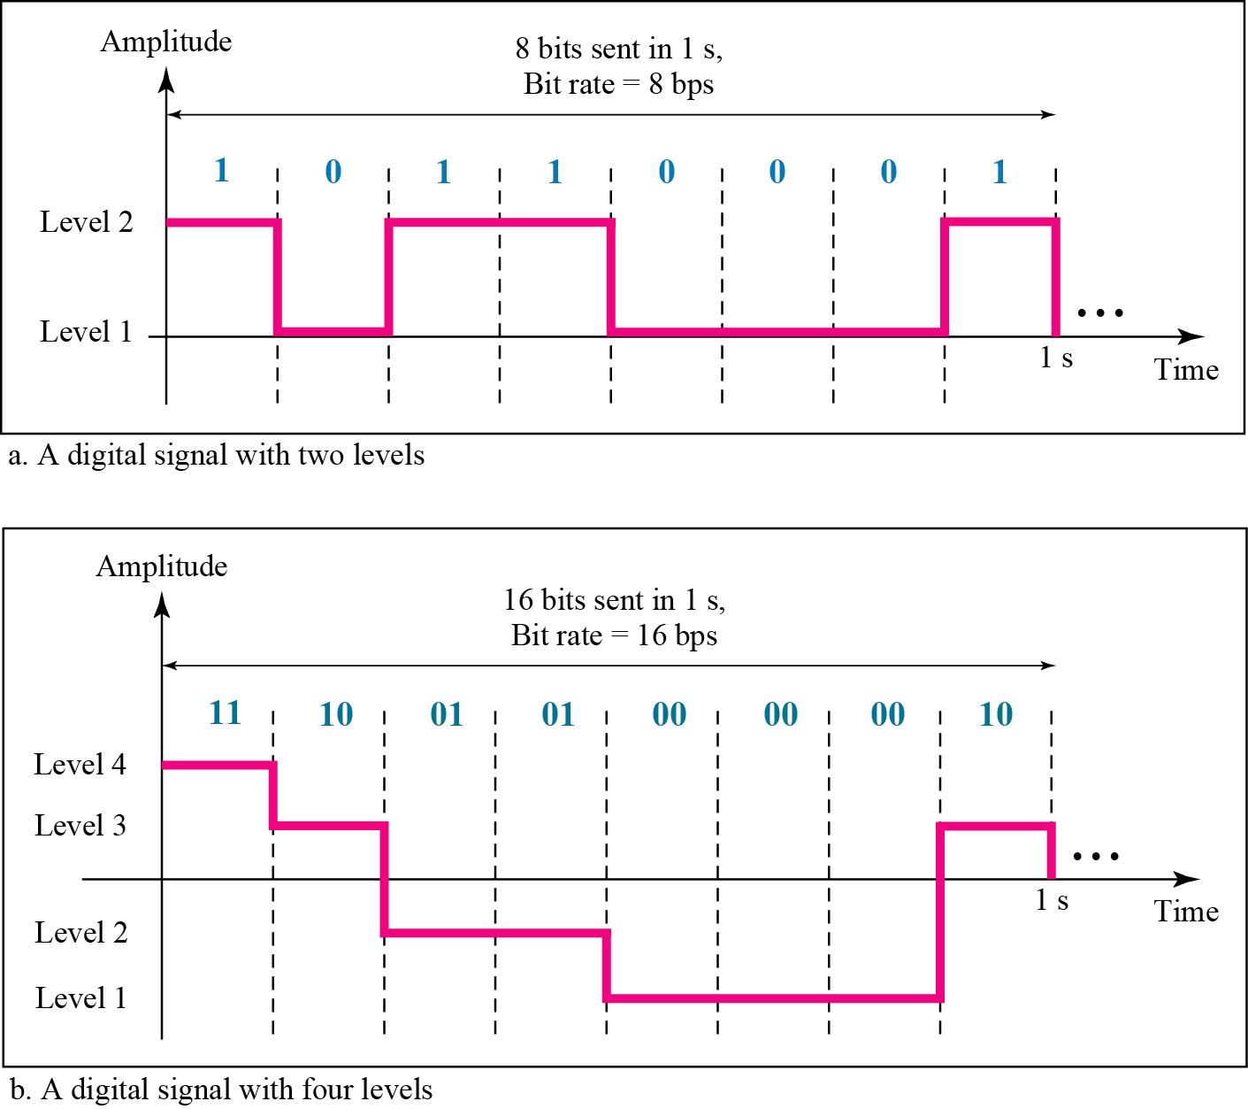
Digital Signals
Information can also be represented by a digital signal. For example, a I can be encoded as a positive voltage and a 0 as zero voltage..
A digital signal can have more than two levels. In this case we can send more than 1 bit for each level

Slide 23
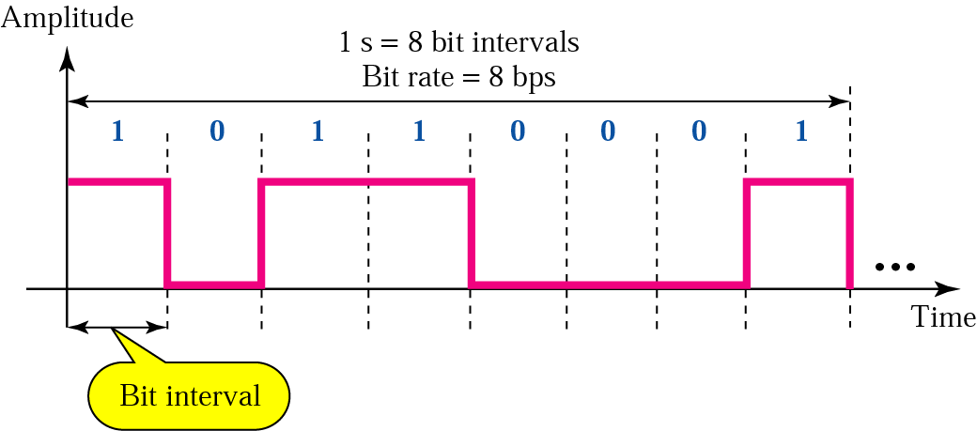
Bit Rate and Bit Interval
Bit interval is the time required to send one single bit.
The bit rate is the number of bit intervals per second, i.e., the number of bits sent in one second. This is expressed as bps.
A digital signal with all its sudden changes, is actually a composite signal having an infinite number of frequencies.

Slide 24
Example 3.18
Assume we need to download text documents at the rate of 100 pages per minute. What is the required bit rate of the channel?
Solution
A page is an average of 24 lines with 80 characters in each line. If we assume that one character requires 8 bits, the bit rate is

Slide 25
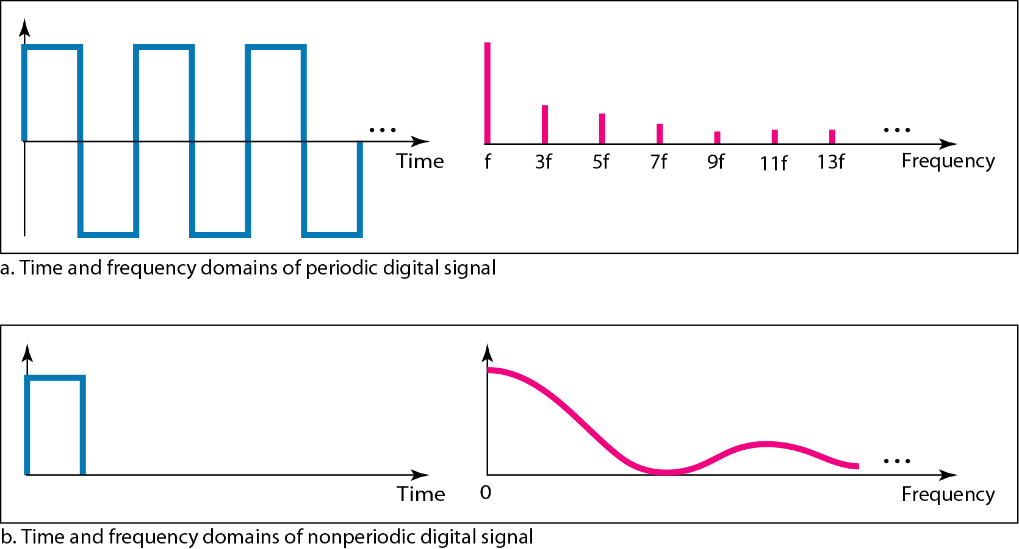
Digital Signal as a Composite Analog Signal

Slide 26
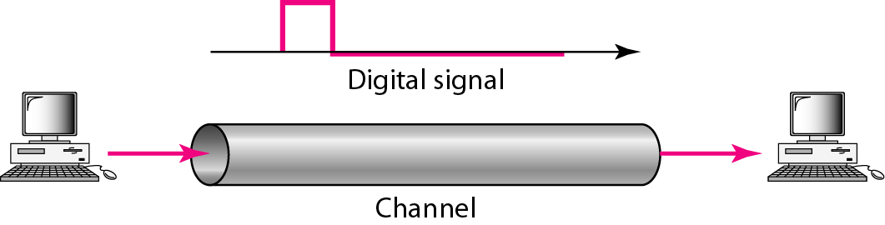
Transmission of Digital Signals
A digital signal is a composite analog signal with an infinite bandwidth
Baseband transmission: Sending a digital signal without changing into an analog signal

Slide 27
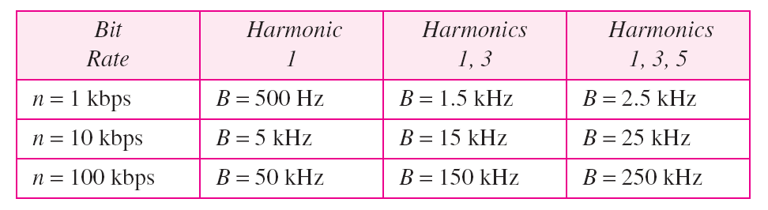
Bandwidth Requirement
In baseband transmission, the required bandwidth is proportional to the bit rate; if we need to send bits faster, we need more bandwidth

Slide 28
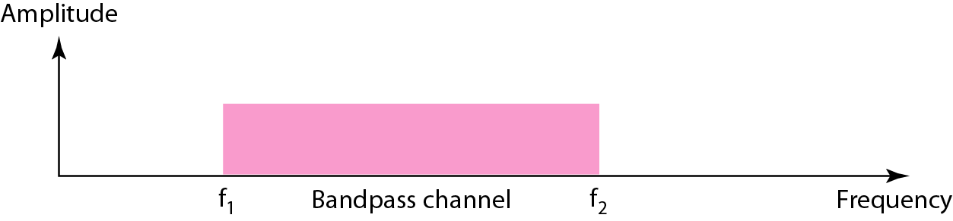
Broadband Transmission
Modulation allows us to use a bandpass channel
If the available channel is a bandpass channel, we cannot send the digital signal directly to the channel; we need to convert the digital signal to an analog signal before transmission.

Slide 29
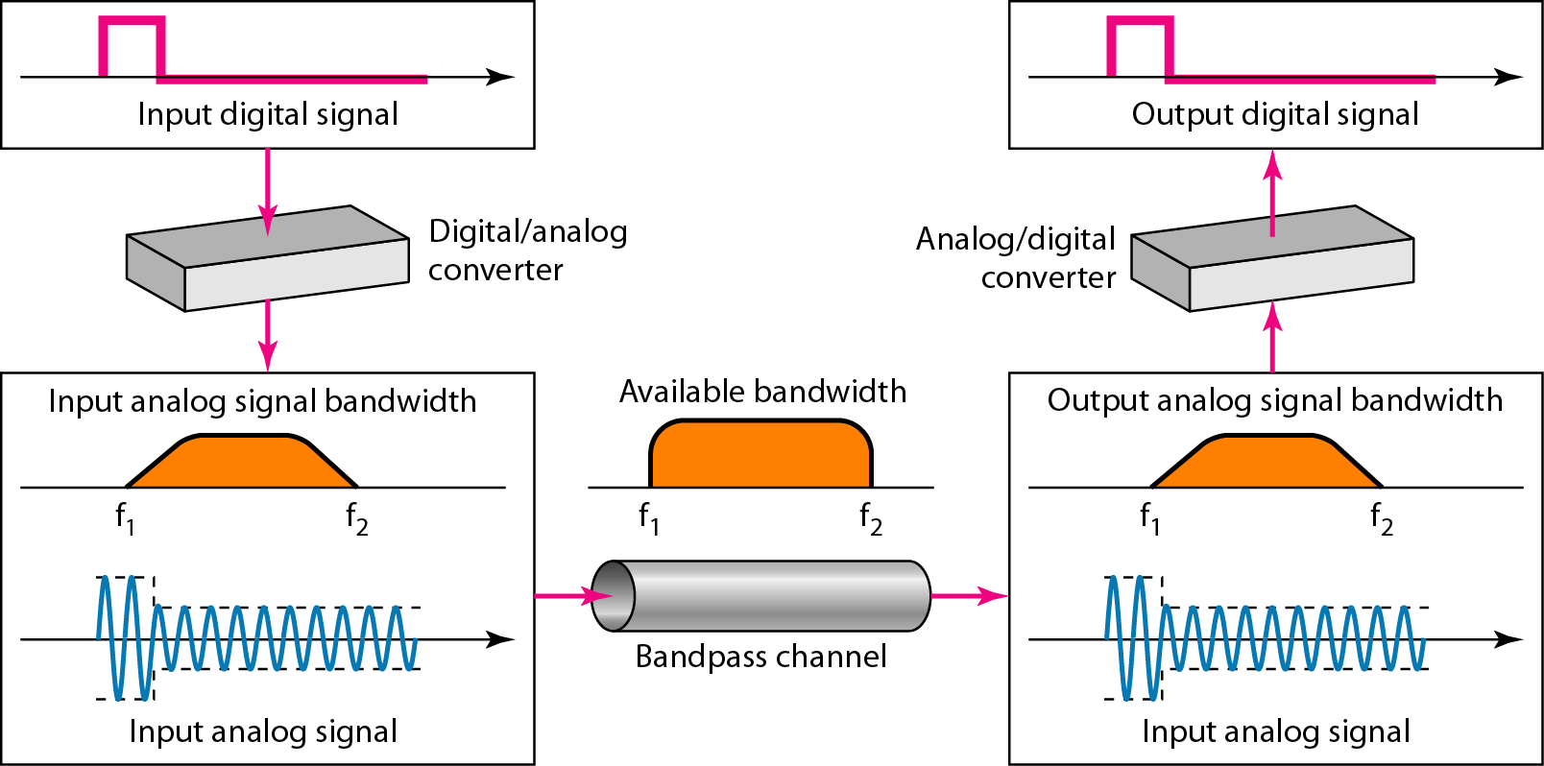
Modulation for Bandpass Channel

Slide 30
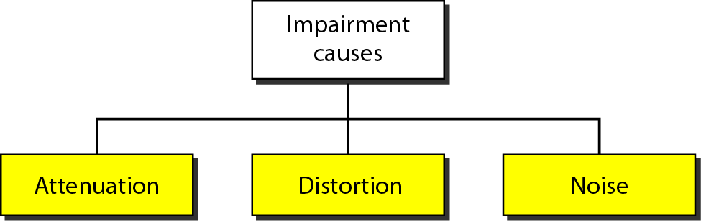
Transmission Impairment

Slide 31
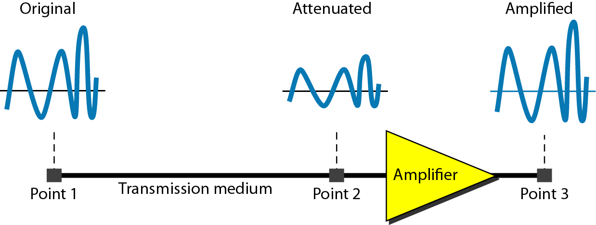
Attenuation
Loss of energy to overcome the resistance of the medium: heat

Slide 32
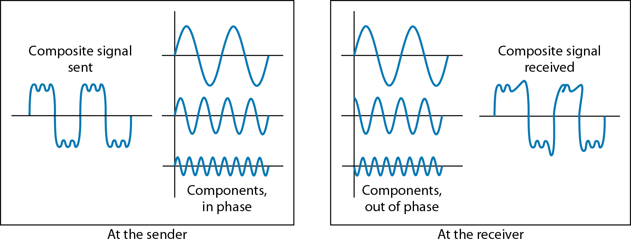
Distortion
The signal changes its form or shape
Each signal component in a composite signal has its own propagation speed
Differences in delay may cause a difference in phase

Slide 33
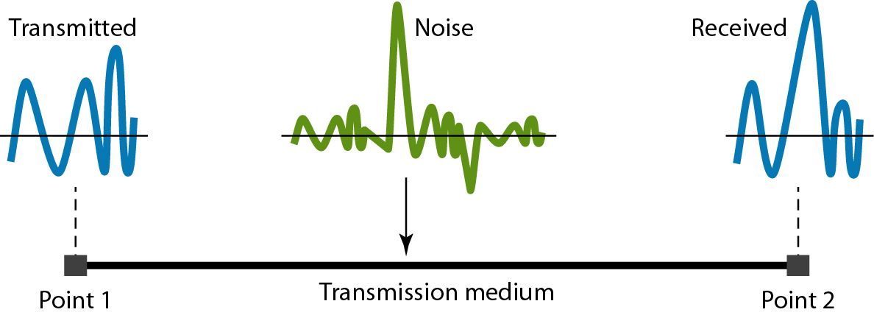
Noise
Several types of noises, such as thermal noise, induced noise, crosstalk, and impulse noise, may corrupt the signal

Slide 34
Signal-to-Noise Ratio (SNR)
To find the theoretical bit rate limit
SNR = average signal power/average noise power
SNR_{dB} = 10 log₁₀ SNR
Example 3.31: The power of a signal is 10 mW and the power of the noise is 1 μW; what are the values of SNR and SNR_{dB} ?
Solution:

Slide 35
Data Rate Limits
Data rate depends on three factors:
Bandwidth available
Level of the signals we use
Quality of the channel (the noise level)
Noiseless channel: Nyquist Bit Rate
Bit rate = 2 * Bandwidth * log₂L
Increasing the levels may cause the reliability of the system
Noisy channel: Shannon Capacity
Capacity = Bandwidth * log₂(1 + SNR)

Slide 36
Nyquist Bit Rate: Examples
Consider a noiseless channel with a bandwidth of 3000 Hz transmitting a signal with two signal levels. The maximum bit rate can be calculated as
Bit Rate = 2 × 3000 × log₂ 2 = 6000 bps
Consider the same noiseless channel, transmitting a signal with four signal levels (for each level, we send two bits). The maximum bit rate can be calculated as:
Bit Rate = 2 x 3000 x log₂ 4 = 12,000 bps

Slide 37
Shannon Capacity: Examples
Consider an extremely noisy channel in which the value of the signal-to-noise ratio is almost zero. In other words, the noise is so strong that the signal is faint. For this channel the capacity is calculated as
C = B log₂ (1 + SNR) = B log₂ (1 + 0) = B log₂ (1) = B × 0 = 0
We can calculate the theoretical highest bit rate of a regular telephone line. A telephone line normally has a bandwidth of 3000 Hz (300 Hz to 3300 Hz). The signal-to-noise ratio is usually 3162. For this channel the capacity is calculated as
C = B log₂ (1 + SNR) = 3000 log₂ (1 + 3162) = 3000 log₂ (3163)
C = 3000 × 11.62 = 34,860 bps

Slide 38
Using Both Limits
The Shannon capacity gives us the upper limit; the Nyquist formula tells us how many signal levels we need.
Example: We have a channel with a 1 MHz bandwidth. The SNR for this channel is 63; what is the appropriate bit rate and signal level?
First, we use the Shannon formula to find our upper limit
C = B log₂ (1 + SNR) = 106 log₂ (1 + 63)
= 106 log₂ (64) = 6 Mbps
Then we use the Nyquist formula to find the
number of signal levels
4 Mbps = 2 × 1 MHz × log₂ L ➔ L = 4

Slide 39
Performance
Bandwidth (in two contexts)
Bandwidth in hertz, refers to the range of frequencies in a composite signal or the range of frequencies that a channel can pass.
Bandwidth in bits per second, refers to the speed of bit transmission in a channel or link.
Throughput
Measurement of how fast we can actually send data through a network
Latency (Delay)
Define how long it takes for an entire message to completely arrive at the destination from the time the first bit is sent out from the source
Latency = propagation time + transmission time + queuing time + processing delay
Propagation time = Distance/Propagation speed
Transmission time = Message size/Bandwidth
Jitter error

Slide 40
Thank you

